Slide 1

Writing ODK Surveys in XLSFORM
Dr Chrissy h Roberts and Dr Michael Marks
London School of Hygiene & Tropical Medicine
opendatakit.lshtm.ac.uk
odk@lshtm.ac.uk

Slide 2
Writing a survey
We write surveys in EXCEL
We use XLS Form Offline to
Check the excel file
Convert it to an XML ODK Form
This talk covers the basics
There are really nice instructions and examples at: xlsform.org
Everything in this talk is from xlsform.org

Slide 3
Writing a survey
Take a blank EXCEL file
Call one sheet: survey
Call second sheet: choices

Slide 4
Survey Sheet
This is the questions you will be asking
For each question we say
Type of Question
Name of Variable
Question +/- Explanation
Is the question mandatory to be completed
When should I ask this question (“skipping”)

Slide 5
Survey Sheet
The top row needs three columns a minimum
Type (CELL A1)
Name (CELL B1)
Label (CELL C1)
It may also need other columns
hint
required
relevant
constraint
constraint_message
(Others)

Slide 6
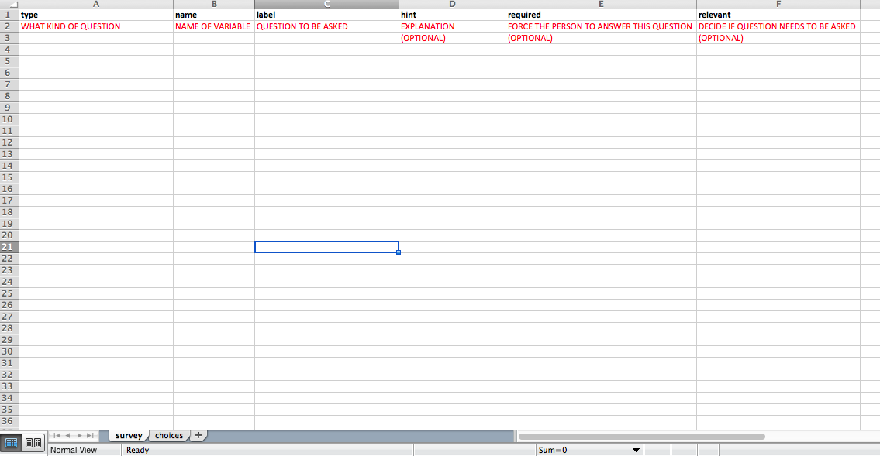

Slide 7
IMPORTANT
You do need the black headings I am showing
The red sub-headings in these slides are just a teaching aid – you shouldn’t include these in your actual file
I’m only showing the columns needed for each example

Slide 8
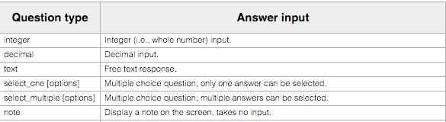

Common types of question

Slide 9
Integer / Decimal / Text / Date / Time / dateTime
This tells ODK that he answer should be numeric and should be an integer
The variable should be called “age”
This is the main question. It will be in big text on the phone/tablet
This is the question hint. It will be in small text on the phone/tablet

Slide 10
Notes
These are an instruction page
They don’t allow data entry

Slide 11

Notes
I want to show a note
I have to give an arbitrary variable name
This is the message that will be shown

Slide 12
Option Lists
For some questions there might be specific options
e.g Multiple choice options
select_one = Only 1 option can be selected
select_multiple = Multiple options can be selected

Slide 13
Option Lists
We put the look-up lists on the “CHOICES” worksheet
We need the following column headings in the first row
list name
name
label

Slide 14
Option Lists
We give each list of options a name:
select_one gender
The list for the question is called “gender”
We save the options on the CHOICES worksheet
You can use the same list for multiple questions
e.g Yes / No

Slide 15
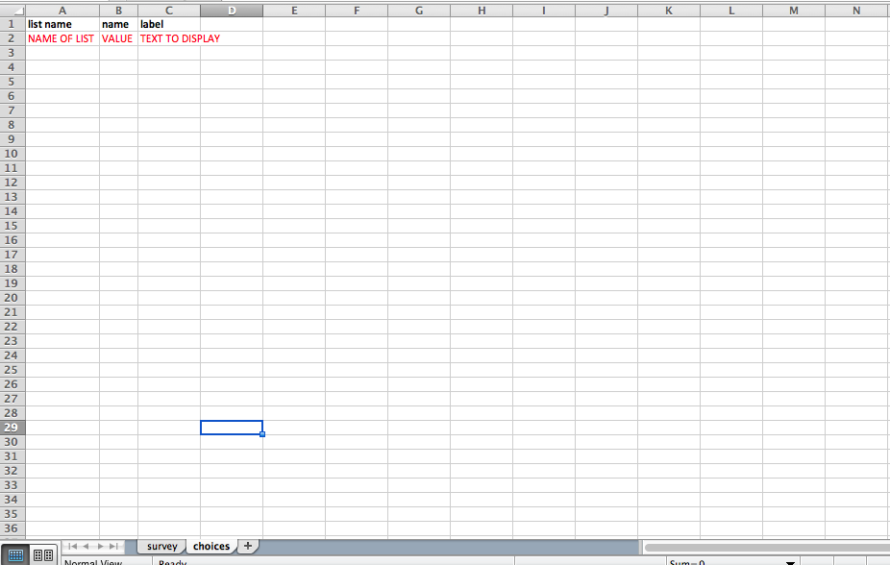
Option Lists

Slide 16


Option Lists
SURVEY WORKSHEET
The user can only select one option
The list of options is called “yes_no”
The variable is called school
The question to be asked
CHOICE WORKSHEET
The name of the list we used on the survey sheet
The underlying value for each option
What the user will see for each option:
The user will see “Yes”
The phone will save “1”

Slide 17
Option Lists
You don’t always know all possible options
You can add the “or_other” command
This adds “Other” as an option to any List
If the user selects “Other” they get a free-text box

Slide 18
Option Lists
The user can select multiple options
The list for the options is called “sport”
An “Other” option will be added to the list in case the user wants to enter an option not on the list.
If the user selects this they will get a free text box for entry.

Slide 19

GPS
We can collect different types of GPS Data

Slide 20

GPS
Select a single GPS point
Call the variable houselocation
The prompt/question the user will see

Slide 21
Barcode
We can scan barcodes
Device needs the BARCODE SCANNER APP
APP STORE
“ZXING TEAM”

Slide 22

Barcode
Scan a barcode
Call the variable “studyid”
The prompt/question the user will see

Slide 23
Media: Audio / Video / Photo

Slide 24

Media: Audio / Video / Photo
Take a photo
Call the variable “eyephot”
The prompt/question the user will see

Slide 25
Required
Forces the user to put an answer in
DON’T USE ON NOTES
user can’t enter a value so will get stuck
Leave this column blank on optional questions
The user must answer this question to be allowed to move on

Slide 26
Relevant and Constraints
We can make certain questions only appear in some circumstances: “RELEVANT”
We can make only some answers acceptable “CONSTRAINT”

Slide 27
Relevant and Constraints
We do this by completing the Relevant or Constraint Column
If the question doesn’t have specific criteria just leave RELEVANT and CONSTRAINT blank for that question

Slide 28
Relevant and Constraints
General Rules
If the RULE (e.g the Constraint) refers to the entry currently being entered then the basic syntax is:
“. RULE”
e.g . <120 == Value entered must be less than 120
If the RULE refers to a different variable then the basic syntax is
${VARIABLE}RULE
e.g ${age} < 5 == if the age is less than 5
e.g selected(${education},’1’)

Slide 29
Relevant
Lets you define questions to be asked if certain other answers are given
e.g only ask Children about education

Slide 30

Relevant
Look at the variable called “Age”
If this value is more than 5 and less than 20 then ask this question

Slide 31
Relevant
Look at the variable called “education”
If the user selected “1” then ask this question.

Slide 32

Constraint
Collect an INTEGER variable called age
Check if the answer is under 120
Show this message if the person enters a value of 120 or more

Slide 33

Constraint
Does the current value match what the user entered in the variable called “right_photo_id”
If the values don’t match show this message

Slide 34
Metadata
You can easily collect Metadata in the background
Time/Date
Device ID

Slide 35
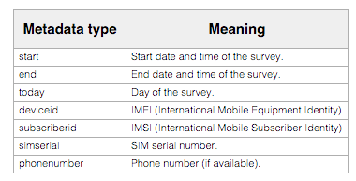

Slide 36
Metadata
Created just like any other variable
User won’t see anything
Data collected in background

Slide 37

Metadata
Type = Type of Metadata
Name = Metadata Variable Name
No other fields required
e.g collect the start day and time of the survey
Collect Start Date and Time
Save the data as a variable called start

Slide 38
Turning the excel into a survey
Once the excel file is finished we save it
Make sure there are no spaces in the name!

Slide 39
XLSFORM.ORG
You can do more clever things including
Calculations
Showing images
Grouping sets of questions
XLSFORM.ORG has nice examples of everything
Consult this for all questions!

Slide 40
XLS Form Offline
Get XLS Form Offline
(it is free, set the price as 0)
We open XLS Form Offline
We select the file we want
Make sure “VALIDATE” checkbox is ticked
Click “RUN”
The software will make a new XML File
E.g survey.xml

Slide 41
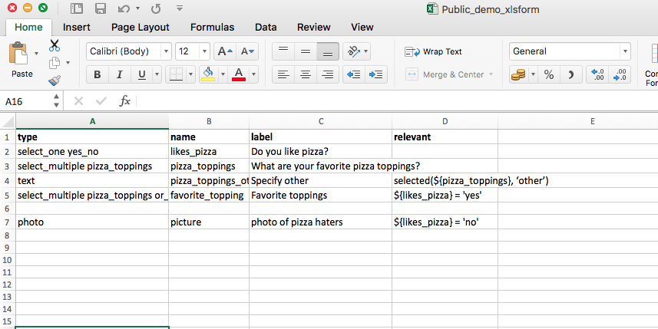
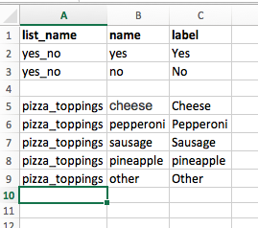

Slide 42
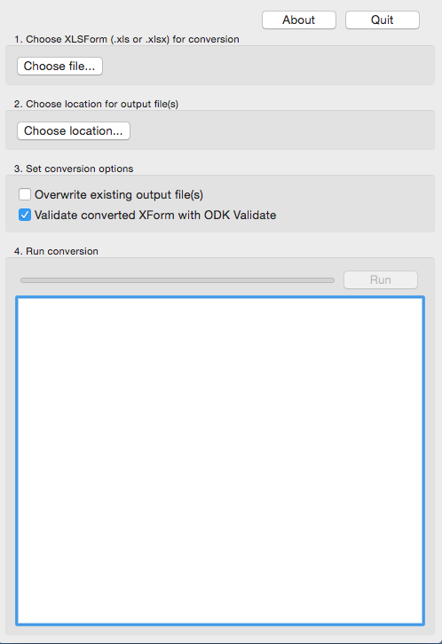

Slide 43
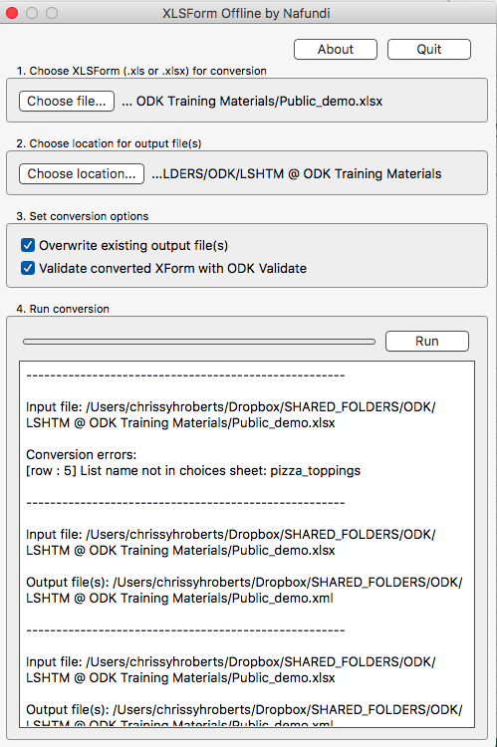

Slide 44
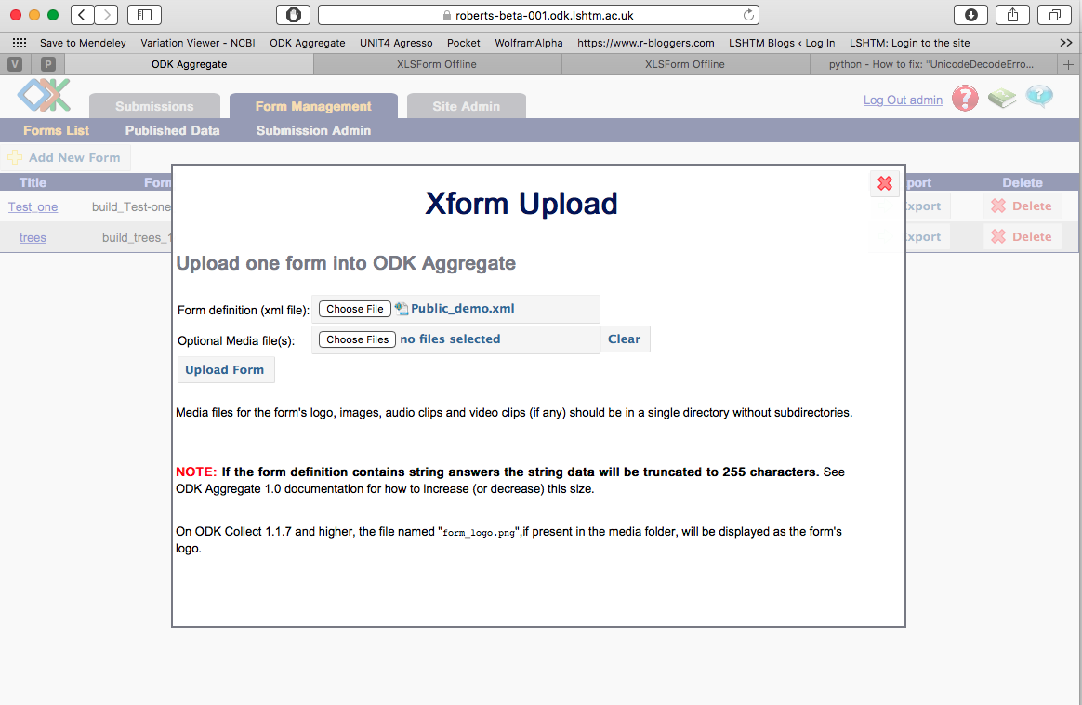

Slide 45
YOU ARE DONE
This file can then be uploaded to an ODK Sever
The ODK @ LSHTM User Manual has instructions for
Uploading forms to the ODK server
Putting forms on mobile devices
Submitting data
The manual is at opendatakit.lshtm.ac.uk

